Slide 1

Communication
Introduction
Department of AS&H

Slide 2
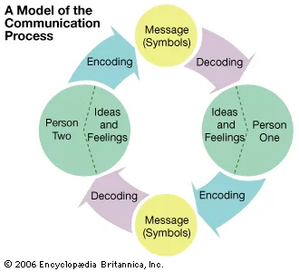
UNIT 1: Fundamentals of Communication

Slide 3
Communication
Communication is from a Latin word ‘communis’, which means common or shared understanding. Communication is hence a purposeful effect to establish commonness between a source and a receiver. Whatever is being shared can be associated with knowledge, experience, thought, ideas, suggestions, opinions, and feelings etc.
In its simplest form, communication is the transmission of a message from a source to a receiver, or the process of creating shared meaning.

Slide 4
Role and Purpose of Communication
Communication serves five major purposes:
to inform
to express feelings
to imagine
to influence
to meet social expectations.
Each of these purposes is reflected in a form of communication.

Slide 5
Types of Communication
VERBAL
It is a method that uses speech in the form of speaking to convey a message or information. It is the most popular and effective mode of communication, usually practiced during video conferences, phone calls, presentations, one-on-one conversations, and meetings. It supports both nonverbal and written communication.
NON- VERBAL
It is basically a practice of gestures, facial expressions, and body language to send information. It can be implemented intentionally and unintentionally when communicating. For instance, a person can smile unintentionally when they hear an interesting piece of information or a pleasant idea.

Slide 6
Communication
7 % VERBAL (Conveyed through words)
38 % VOCAL (intonation , pitch, pauses , etc)
55 % NON VERBAL (body language)

Slide 7
Verbal Communication
It is a method that uses speech in the form of speaking to convey a message or information.
It is the most popular and effective mode of communication, usually practiced during video conferences, phone calls, presentations, one-on-one conversations, and meetings.
It supports both nonverbal and written communication.
It also includes written words, typing, printing, writing to send a piece of information.

Slide 8
Non-Verbal Communication
It is basically a practice of gestures, facial expressions, and body language to send information.
It can be implemented intentionally and unintentionally when communicating.
For instance, a person can smile unintentionally when they hear an interesting piece of information or a pleasant idea.

Slide 9

Body language
Gestures
Poses
Movements
Expressions

Slide 10
Kinesics
The physical movement of the body and their study is known as body language or kinesics.

Slide 11
Kinesics
1
1)Maintain eye contact
2
2)Face and eyes
3
3)Gestures
4
4)Body shape and posture
5
5)Appearance

Slide 12

Facial Expressions
O The face is most powerful channel of nonverbal communication
O Whether we want it or not, we always indulge in encoding/decoding of facial
expressions when we listen or talk to someone
O Even in the simplest interaction, we normally focus our attention on face .
O By identifying the facial expressions appropriately, we can come to know of interest, attraction, identity, background, age, character (humorous, serious, dull, charming, etc.) involved in communication

Slide 13

Types of Facial Expressions
Inhibited – Restricted and stolid Uninhibited – Spontaneous and impetuous Substitute – Happy with a long face.
Frozen – No change in expression Blank - No expression at all.

Slide 14


Eyes
Apart from focusing on face, people in an interaction pay attention to eyes of the other person
Like face, eyes are highly expressive and send multiple messages during communication

Slide 15
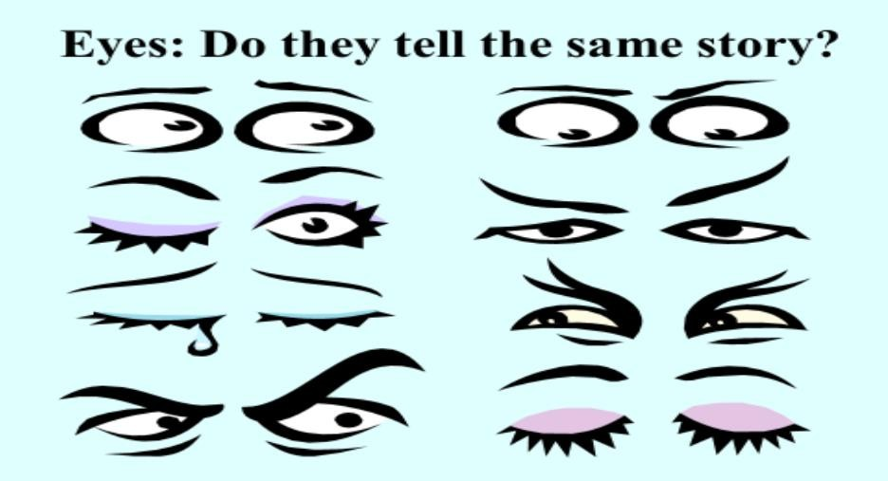
Do each set of eyes tell you the same story?

Slide 16
Oculesics involves the study of expressions and messages conveyed by the eyes in the form of gaze, eye contact, pupil dilation, and eye movement.

Slide 17
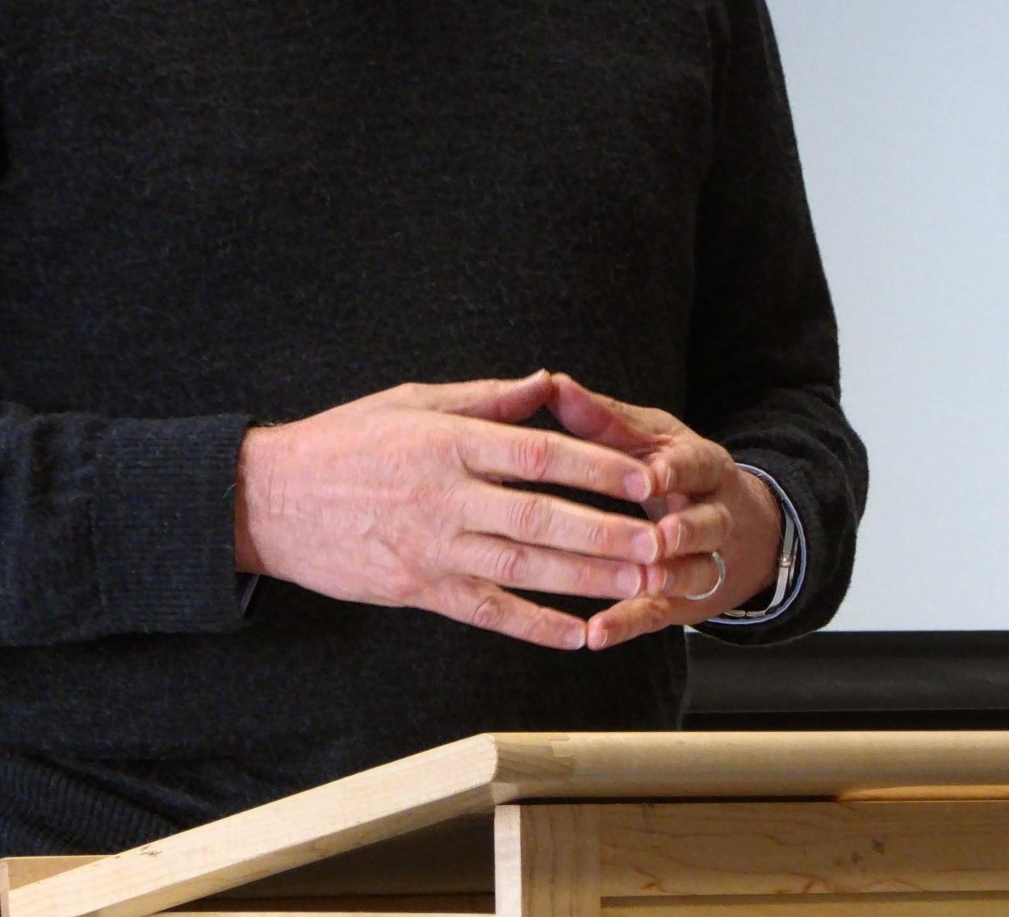
Gestures
In addition to the face and eyes, other body parts move and convey meaning. These movements are known as gestures, the physical movement of arms, legs, hands and head.

Slide 18



Types Of Gestures
Descriptive gesture
Emphatic Gestures Enumerative Symbolic
Locative

Slide 19


Posture
The position in which someone holds their body while standing or sitting is known as posture

Slide 20

) Slumped posture – low spirits
ii) Erect posture – High spirits, energy and confidence.
Types of Postures
iii) Lean Forward – Open, honest and interested.
iv) Lean Backward – Defensive or disinterested.
Crossed arms – Defensive and not ready to listen.
Uncrossed arms – Willingness to listen.

Slide 21
ARMS FOLDED ACROSS THE CHEST : UNSYMPATHETIC
SAGGING : DEPRESSION
FORWARD LEAN : POSITIVE ATTITUDE
BACKWARD LEAN
: NEGATIVE ATTITUDE
ARMS HELD LOOSE : OPEN POSITIVE ATTITUDE
UPRIGHT POSTURE : HIGH STATUS , I AM THE BOSS
BOWING HEAD : LOWER STATUS
SIDEWAY LEAN : RELAXATION, FRIENDLINESS
SELF WRAPPING : WITHDRAWAL, SELF PROTECTION
SLOUCHING WITH FORWARD LEAN : LOWLINESS
MODERATELY UPRIGHT : ENTHUSIASM, FRIENDLINESS
SOME COMMON POSTURES

Slide 22
Appearance
The impression people make on one another is based 60% on their appearance, 33 % on the way in which they speak and 7 % on what they say”

Slide 23

Appearance
External appearance in which our dress, jewellery
and make up play a pivotal role
The speaker should consider how others will view him in relation to how he wants to be seen.
He should dress up himself in simple and sober dress.

Slide 24

Proxemics

Slide 25

Proxemics ( Space language )
Proxemics is the study of the use of space, distance, and proximity in interpersonal communication.

Slide 26

Proxemics
Edward T. Hall has given four types of space language, depending on the distance:
Intimate Space Language:
Personal Space Language
Social Space Language
Public Space Language

Slide 27
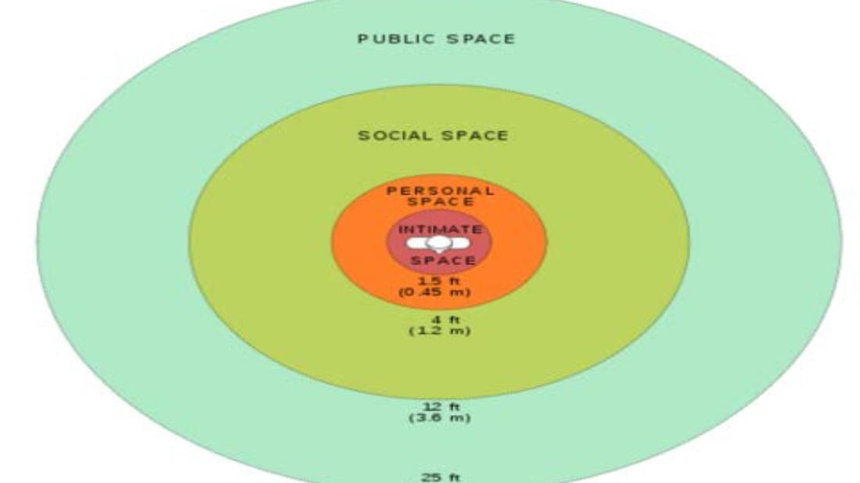



Slide 28

Chronemics/ Time Dimension
Chronemics is the study of the way we structure and use time. Using time implies the meaning we attach to it.

Slide 29


Monochromic people
Such type of people concentrate on their job and take time commitments seriously
They are committed to their job and understand their responsibility towards the organization they work in .
For such type of people timing is very important . For them timing is like commodity , it is
scheduled , managed and arranged. They Usually take up one task at a time

Slide 30

Polychromic People
Such type of people try to do many things at once. They have less importance of professional commitments in their life. They can break an appointment or meeting if their family needs them without any guilt. Or an apology.

Slide 31


Paralinguistic features of voice

Slide 32
Paralinguistic features of voice / Nuances of Voice Dynamics
The study of language is called as linguistics.
Para means like .
Paralingustic communication refers to the study of human voice and how the words are spoken.
Also known as vocalics.
Paralinguistics features are non-verbal vocal cues that help you to give urgency to your voice. Your voice is your trademark; it is that part of yourself that adds human touch to your words.

Slide 33


1.Quality
2.Volume
3.Pace/Rate
4.Pitch
Paralinguistic features
5.Articulation
6.Pronunciation
7.Voice Modulation
Pauses

Slide 34

Quality
Quality is a characteristic that distinguishes one voice from another
Each of us has a unique voice and it depends on its resonating mechanism
It may be soft & alluring(Arijit Singh), rich and resonant(Amitabh Bachan) , thin and nasal (Himesh Reshamiya), hoarse & husky( Rani Mukhrjee) or harsh & Irritating..
uAbhram Linchon & Winston Chrurchill have adapted the quality of voice to become speakers par excellence.

Slide 35

Volume
Volume is the loudness or the softness of the voice
Voice should project but it needs not to be loud.
If the place you are speaking in is large the volume should be hig
or else, it should be low.
If volume is too high, we may sound boorish and insensitive, whereas if it is too low, we may convey the impression of timidity.
Thus, we should vary our volume to make our voice clear and
audible.

Slide 36

Rate/Pace
The number of words that one speaks per minute
Varies from 80 to 250 words from person to person Normal rate is from 120 to 150 words per minute
A well paced ,varied message suggests enthusiasm , self- assurance and awareness of audience

Slide 37

Pitch/Tone
Pitch refers to the number of vibrations per second of your voice.
The rise and fall of pitch conveys a lot of emotions.
Lowness of pitch can indicate dullness, shock, sadness etc.
When we are excited , joyous, triumphant and even angry pitch automatically becomes high. Variety of pitches should be used to hold listeners attention

Slide 38

Pitch
The tone and pitch height may express attitudes of a person
FALL : It shows neutral statement.
RISE: Neutral question, Doubt FALL-RISE : Skepticism
RISE-FALL: Emphatic Statement LEVEL : Boredom, Disinterest

Slide 39

Articulation
Articulation is the aspect of pronunciation that involves bringing articulatory organs so as to shape the sounds of speech.
Speakers should be careful not to slop, chop, truncate, or omit sounds between words or sentences.
If all the sounds are not uttered properly , the flow of understanding gets interrupted and deters listeners from grasping the meaning of the message

Slide 40
Pronunciation
If articulation means speaking out all the sounds distinctly, then pronunciation requires us to speak out sounds in way that is generally accepted. The best way is to follow British Received Pronunciation.
It is generally influenced by the geography & culture.

Slide 41

Voice Modulation
Voice modulation is the way we regulate, vary, or adjust the tone, pitch, and volume of the sound or speaking voice.
It brings flexibility and vitality to the voice, and we can express emotions, sentiments in the best possible way.
If we do not pay attention to the voice modulation then our voice, becomes flat and we emerge as a languid speaker with no command over our voice

Slide 42

Pauses
Is a short silence flanked by words.
In speaking let's the listener reflect on the message
And digest it accordingly.
Also help speaker to glide from one thought to another.
Embellishes the speech as it is a natural process to give a break.
Vocalized pauses or vocal segregates such as uh, ah, umm should be replaced
with the silent pauses.

Slide 43
Flow of Communication
Downward
Upward
Horizontal
Diagonal

Slide 44
Flow of Communication
Flow of Communication
Formal
Upward
Downward
Informal
Grapevine
horizontal
Diagonal

Slide 45
Downward Communication
Downward communication refers to the communication from the higher level in in managerial hierarchy to the lower ones. It is a communication from decision makers to the workers. It is a communication from seniors to their subordinate employees.
The main function of downward communication is providing direction and control. It involves the transfer of information, instruction, advice, request, feedback and ideas to the subordinate staff. It increases staff awareness and facilitates implementation
New policies
Guidelines
Decisions
Evaluations
Appraisal

Slide 46
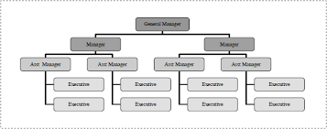
Example

Slide 47
Forms of downward communication may include
Notes
▪ Notices
▪ Memos
▪ Telephone conversations
▪ Voice mails
▪ Emails
▪ Face to face conversations
Too much downward communication may lead to reaction from subordinates and can hamper
better employee - employer relationship.

Slide 48
Upward Communication
This type of communication refers to-
Communication from subordinates to superiors
Communication from employees to management.
Communication from workers to decision makers
Since upward communication involves the transfer of – information, request and feedback from subordinates to their seniors, it promotes better working relationships within an organization by giving the subordinate staff opportunities to share their views and ideas with their supervisors. It facilitates employee involvement in the decision-making process.

Slide 49
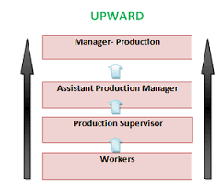

Slide 50
Examples of Upward Communication:
A business report from the branch manager of a company to the managing director of the company is an example of upward communication.
Other examples of upward communication include –
Business proposals
Suggestion box
Exit interviews

Slide 51
Horizontal or Lateral or Peer Group Communication
It takes place between professional peer groups or people working on the same level of hierarchy.
It is the communication among workers at the same level
The main objectives of horizontal communication are
Developing teamwork
Promoting group coordination within an organization

Slide 52
Horizontal or Lateral or Peer Group Communication Examples
Horizontal communication is less formal and structured than both downward and upward communication and may be carried out through
Informal discussions
Management gossip
Telephone calls
Teleconferencing
Memos
Routine meetings

Slide 53
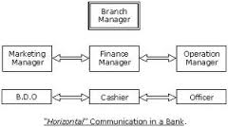

Slide 54
Diagonal or Cross-wise Communication
It is the product of modern changes in information technology and management. It is basically a response to market needs that demand speed and efficiency.
Diagonal communication flows in all directions. As the diagonal channel occurs between people who do not have to follow rigid norms of communication protocol.

Slide 55
Grapevine Communication
According to Bovee and Others, “Grapevine is an informal interpersonal channel of information not officially sanctioned by the organization.
Newstrom and K. Davis said, “Grapevine is an informal system that arises spontaneously from the social interaction of the organization.”
So, grapevine is an informal, unofficial and personal communication channel or system that takes place within the organization as a result of rumor and gossip. It is a complex web of oral information flow linking all the members of the organization.

Slide 56
Patterns or Types of Grapevine
Single Strand
Gossip Chain
Probability Chain
Cluster Chain

Slide 57
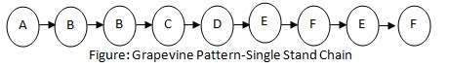
Single Strand Chain
The single strand chain involves the passing of information through a line of persons to the ultimate recipient. In the figure, the person A tells B, who tells C, who tells D, and so on, till the information has reached most of the persons involved or concerned.

Slide 58
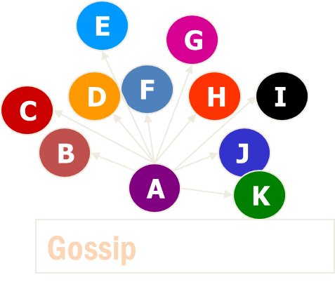
Gossip Chain
In the gossip chain, one person seeks and tells the information to everyone. This chain is just like the wheel where one person stays at the center and the information passes along the spokes of the wheel to others stationed on the rim. In the following figure, A is at the center and passes the information to others staying on the rim of the wheel.

Slide 59
Probability Chain
The probability chain is a random process in which someone transmits the information to others in accordance with the laws of probability and then these others tell still others in a similar way. This chain may also be called random process.
E
C
K
H
G
I
X
F
B
D
J
A
Probability

Slide 60
Cluster Chain
In the cluster chain, a person tells the information to the selected persons who may in turn relay (pass) the information to other selected persons. Most of the information communication follows this chain
J
B
I
D
C
F
Cluster
A

Slide 61
ADVANTAGES
Grapevine channels carry information rapidly.
Feedback obtained is quick
Serves as an emotional supportive value
The grapevine is a supplement
Creates a sense of unity among the employees

Slide 62
Barriers to Effective Communication

Slide 63
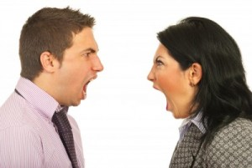
What is a Barrier ?
Communication barrier means various disturbances in communication process which hamper (obstruct) the smooth flow of effective communication..

Slide 64
Classification Of Barriers
Barriers
Intrapersonal
Interpersonal
Organisational

Slide 65
Intrapersonal Barriers
Intrapersonal barriers stem from an individual’s attitudes or habits. Individuals are unique because of their idiosyncrasies (unique qualities). This is mainly because of differences in experience, education and thinking abilities. Each of us interpret the same information in different ways as our thinking varies. The causes that lead to intrapersonal barriers are…

Slide 66
Intrapersonal Barriers
Wrong assumptions
Differing backgrounds
Impervious Categories
Varied perceptions
Wrong inferences
Categorical Thinking

Slide 67
Wrong assumptions (suppositions)
Many barriers stem from wrong assumptions. For example, when a doctor tells his
patient that he must take a medicine only as ‘SOS’, without knowing whether the
patient understands the term or not, he is creating a barrier in his communication.
Here the doctor has made a wrong assumption about his patient’s level of
knowledge. Wrong assumptions generally occur when the sender and receiver do
not have adequate knowledge about each other’s background, or entertain certain
false notions (ideas), which are fixed in their mind. In order to strengthen your
skills as a communicator try to put yourself in the shoes of the listener. This
exercise will prevent making wrong assumptions about the receiver.

Slide 68
Varied perceptions (understanding differently)
Different people have their different views.
We all know the story of six blind men of Burma, who visited an elephant and their
description of the elephant on returning from the venture. The elephant is
perceived by each man as a fan, a rope, a wall, a sword, a snake, and a tree. None
of the blind men is wrong, as the part of the elephant body touched by each man
was compared with various objects. This is how an individual perceives reality.
Similarly, individuals in an organization also perceive situations in different
ways. Let us take the case of an argument between two individuals. If you are close
to one of them, you are likely to be biased. You may perceive your friend’s
arguments as correct, and hence, may not be able to appreciate his opponent’s
point of view. It is all a matter of perception. The best way to overcome this barrier
is to take a wider view of the issue.

Slide 69
Differing backgrounds
No two persons have a similar background. People vary in terms of their education,
culture, language, environment, age, financial status, etc. Our background plays a
significant role in how we interpret a message. At times, something not
experienced by you earlier will be difficult to interpret or appreciate. Think of a
discussion where somebody talks about his mountaineering expedition experience.
Those people who have had the experience of trekking may be able to appreciate
the talk, but others who have not trekked before may not find it interesting at all.
To overcome this barrier, one should know the background of his audience
and use the information accordingly to deliver his message effectively.

Slide 70
Wrong inferences
To draw wrong conclusion about something without knowing the facts can also lead to communication barrier. For example, you have planned a trip with some of your friends, suddenly one of your friends could not make the trip, you draw the conclusion that he has not come due to studies, but the fact is that he had taken ill.

Slide 71
Impervious (inflexible) categories
In general, we have own views and attitudes. Conversely, when we receive information that does not conform (match) to our personal views, habits and attitudes, or appears unfavorable to us; we tend to react negatively or even disbelieve. Rejection, distortion and avoidance are three common, undesirable and negative reactions to unfavorable information
People who are very rigid in their opinions and are not ready to accept any
view which is different from their own, fall into impervious categories. Such
closed minded people face problem in communicating effectively and are known
as misoneist.

Slide 72
Categorical thinking
People who feel that they ‘know it all’ are called pansophists. This type of thinking
exists among people who feel that they know everything about a particular subject
and therefore, refuse to accept any further information on that topic. For example,
in a General Body meeting of your organization, you are to be briefed about the
annual budget. However, you do not pay attention because you feel you have
already been briefed about it by your secretary the previous day. Later you propose
that new vehicles to be bought. Imagine your embarrassment when you realize that the topic was discussed, and a decision had already been taken in the
general body meeting. This type of thinking can pose a major barrier leading to a
failure in communication. In such instances, the receivers refuse information
because of their ‘know-it-all’ attitude.

Slide 73
Interpersonal Barriers
Interpersonal barriers creep in as a result of the limitations in the communication
skills of the encoder or decoder, or both. In addition, they may also occur because
of some disturbance in the channel. If two people are involved in communication,
the traits that distinguish them as individuals can be the root cause of a
communication problem. The most common reasons for interpersonal barriers are

Slide 74
Interpersonal Barriers
Limited vocabulary
Emotional outbursts
Cultural variations
Incongruity of verbal and nonverbal messages
Communication selectivity
Poor listening skills
Noise

Slide 75
Limited vocabulary
Inadequate vocabulary can be a major hindrance in communication. At times, your
pen falters, or your tongue fumbles as you search for the exact word or phrase. In
your communication, the meanings of your words should be clear to the
receiver. During your speech if you are at a loss for words, your communication
will be ineffective, and you will leave a poor impression on the audience. On the
other hand, if you have a varied and substantial vocabulary, you can create an
indelible impression on your listeners.
Also remember that merely having a good vocabulary is of no use unless the
communicator knows how to use it. Therefore, one should make constant efforts to
increase one’s vocabulary by regularly reading a variety of books and listening to
native speakers of the language.

Slide 76
Incongruity of Verbal and Non-verbal Messages
Inappropriateness between verbal and non-verbal messages also causes barrier in
communication. Imagine a situation where your CEO introduces a newly recruited
middle-level manager to other employees. In a small speech, he conveys the
message that he is very delighted to have the new manager appointed in his office.
However, his face expression shows just the opposite of what he is saying. The
stark difference between the verbal and non-verbal aspects of his communication
leaves his listeners feeling confused and puzzled. A communicator should acclimatize himself to the communication environment, think from the angle of the
listener, and then communicate.
It is important to remember that physical appearance can have a great impact on
any kind of conversation. Guidelines to improve physical appearance are as
follows:
• Dress according to the occasion
• Wear neat and clean clothes
• Choose an appropriate hairstyle
• Wear clean and polished shoes.

Slide 77
Emotional Outburst
Emotions are integral part of every human being. A moderate level of emotional
involvement intensifies communication. However, excessive emotional
involvement can be an obstacle in communication. For example, extreme anger can
create such an emotionally charged environment that rational discussion is just not
possible. Positive emotions like happiness and excitement also interfere in
communication, but to a lesser extent than negative feelings.
Very often people react negatively. Depending on their nature and situation,
this negative reaction may either be classified as hostile or defensive. Hostility can
be considered as a move to counter-attack the threat, whereas defensiveness is
resistance to it. Both occur in situations where the receiver of the message
perceives threat. Both these responses have an extremely negative
impact on the communication. Messages are either misinterpreted, ignored, or
overreacted to by people displaying such behavior. Those who witness such
behavior are most likely to lower their opinion about the sender of such messages.

Slide 78
Communication Selectivity
If you are the receiver in a communication process, and you pay attention only to a part of the message, you are imposing a barrier known as communication selectivity. You do this because you are interested only in that part of the message which may be of use to you. In such a situation, the sender is not at fault. It is the receiver who breaks the flow of communication.

Slide 79
Cultural Variations
Effective communication with people of different cultures is challenging.
Communication failure may occur when sender and receiver belong to different
cultures. The sender encodes a message with some meaning but the receiver who
belongs to other culture, decodes some other meaning.
Cultures provide people with different ways of thinking, seeing, hearing, and
interpreting the world. Thus, the same words can mean different things to people
from different cultures, even when they talk the "same" language. When the
languages are different, and translation must be used to communicate, the
potential for misunderstandings further increases.

Slide 80
Poor Listening Skills
A common obstacle to communication is poor listening skills. The various
distractions that hinder listening can be emotional disturbances, indifference,
aggressiveness and wandering attention.
Sometimes, an individual is so occupied in his own thoughts and worries
that he is unable to concentrate on listening. If a superior goes on shifting the
papers on his desk while listening to his subordinate, without making eye contact
with the latter, he pays divided attention to the speaker’s message. This divided
attention adversely affects the superior – subordinate relationship, besides
distorting the communication

Slide 81
Noise
Noise interferes greatly in the transmission of signals. Noise is any
unwanted signal which acts as a hindrance in the flow of communication. It is not
necessarily limited to cacophony, but can also occur in visual, audio-visual, written
and physical forms. All these forms of noise communicate irrelevant matter which
may allay the receiver’s interest in the message, even irritate him.
Technical or physical noise refers to the din (sound) of machines, the blare
of music from a stereo system, or other such sounds which make the task of the
listener difficult. Human noise can be experienced when, for instance, employees
gather for a meeting and a member arrives late distracting everybody’s attention.
Disturbance in telephone lines is also an example of technical noise

Slide 82
Organizational Barriers
Communication barriers are not only limited to an individual or two people but
exist in entire organizations. Every organization, irrespective of its size, has its
own communication techniques, and each develops its own communication
network. Irrespective of size, all organizations have communication policies which
describe the protocol to be followed. It is the structure and complexity of this
protocol that usually causes communication barriers.
The main organizational barriers are enumerated below:

Slide 83
Organizational Barriers
Too many Transfer Stations
Negative Tendencies
Information overload
Fear of Superiors
Use of Inappropriate media

Slide 84
Too many Transfer Stations
The more links there are in a communication chain, the greater are the chances of
communication failure. The message gets distorted at each link not only because of
poor listening or lack of concentration, but also because of several other reasons.
Some employees may filter out a part of the message which they consider
unimportant. Whatever the reasons for filtering or distorting the message, having
too many transfer stations is always a deterrent to effective communication and
should be avoided. Transfer stations do serve a purpose, but having too many of
them proves counterproductive.

Slide 85
Fear of Superiors
In rigid structured organizations, fear of the superiors prevents subordinates from
speaking, frankly. An employee may not be pleased with the way his boss works
but is unable to put his point across because of losing the good will of his boss. As
a supervisor, it is essential to create an environment which enables people to speak
freely. An open environment is conducive to increasing the confidence and good
will of a communicator. To avoid speaking directly to their boss, some employees
may either shun all communication with their superiors or, at the other extreme,
present all the information that they have. This is because they feel that they would
be viewed in unfavorable light if they left out some vital information. In written
communication, this results in bulky reports where essential information gets
clubbed with unimportant details. Such unfocussed messages result in a lot of time
waste. Such practices need to be eliminated by superiors to ensure that
communication flows effectively in their organizations. Moreover, by encouraging
active participation from their subordinates, senior officers pave the way for more
ideas, resources and solutions to come forth from their juniors.

Slide 86
Negative tendencies
Many organizations create work groups. While some groups are formed according
to the demands of the task, such as accomplishing a particular project, many other
small groups are also formed for recreational, social, or community purposes.
These groups may be formal or informal, and generally consist of people who
share similar values, attitudes, opinions, beliefs, and behavior. Nevertheless, on
some occasions, it is possible to have communication barrier due to a conflict of
ideas between members and non-members of a group. Such conflicts pave the way
for negative tendencies in an organization. Once these negative tendencies
develop, they create barrier in inter-personal communication.
However, good managers can take advantage of these situations by
considering these groups not as troublemakers, but as re- enforcers of the
organization’s objectives and values. Experienced administrators can even make
these groups organize orientation sessions for new recruits, thereby projecting the
corporate image.

Slide 87
Use of Inappropriate Media
Some of the common media used in organizations are graphs and charts,
telephones, facsimile machines, boards, e-mail, telephones, films and slides,
computer presentations, teleconferencing, and video conferencing. While choosing
the medium you should keep in mind the advantages, disadvantages and potential
barriers to communication before sending a message, you should consider the
following factors while choosing a medium:
• Time
• Cost
• Type of message
• Intended audience
Usually, a mix of media is best for effective communication. For example, a
telephone call to book an order, followed by a confirmatory letter ensures that
there is no possible misunderstanding of the message

Slide 88
Information Overload
One of the major problems faced by organizations today is the availability of huge
amounts of data which the receiver is unable to handle effectively. This is known
as information overload.
The usual results of information overload are tiredness, disinterest, and
boredom. Under these circumstances, further communication is simply not
possible.
Very often, vital, relevant information gets mixed up with too many
irrelevant details, and therefore goes ignored by the receiver. Thus, the quality of
the information is much more important than the quantity.
To reduce information overload in an organization, screening of information
is mandatory. Messages should be directed only to those people who are likely to
benefit from the information. Major points should be highlighted, leaving out all
irrelevant details. This kind of screening will be appreciated by all and can reduce
the problem of information overload to a great extent

Slide 89
7 C’s of Communication
Clear
Concise
Concrete
Correct
Coherent
Complete
Courteous

Slide 90
Code and Content
Any human communication system involves the production of a message by someone, and the receipt of that message by someone else. To encode a message, one must possess the necessary encoding skills.
Languages are codes. A code may be defined as any group of symbols that can be structured in a way that is meaningful to another person. The English language, like any other language, is a code—it contains element that are arranged in a meaningful order. A code has a group of elements (vocabulary) and a set of procedures for combining these elements meaningfully (syntax).

Slide 91
Code and Content
Next is the message content, i.e., the message that is selected by the source to express its purpose. Content, like codes, has both element and structure. When more than one piece of information is to be presented, they should have some order or structure.
An individual may sometimes be identified by his characteristic way of structuring messages. This is because the individual communicates in a way that is distinctive to him. He uses a distinctive way or method, which has become his habit by constant use.

Slide 92
Stimulus and Response
Stimulus and response are the two terms that are frequently used in any discussion on the communication process.
A ‘stimulus’ is anything that a person can receive through one of his senses. In fact, it is anything that can produce a sensation. And a ‘response’ is anything that an individual does as a reaction to the stimulus.
These two terms, stimulus and response, are ultimately connected with the whole learning process. The communication objective of the source is to bring about a change in the behavior of the receiver.

Slide 93

Vowel Sounds
There are 20 vowel sounds in English language which comprises of monophthongs and diphthongs.
Vowels are voiced sounds during the production of which the air escapes through the freely and continuously without any audible frictional voice.

Slide 94

Monophthongs
1. /i:/ as in beat /bi:t/ - unrounded
2. /I/ as in bit /bit/ unrounded
3. /e/ as in bet /bet/ -unrounded
4. /æ/ as in bat /bæt/ -unrounded
5. /ʌ/ as in but /bʌt/ -unrounded
6. /a:/ as in bard /ba:d/-unrounded
7. /ɒ/ as in God /gɒd/-rounded
8. /ɔ:/ as in caught /Kɔ:t/ - rounded
9. /u/ as in put /put/ - rounded
10./u:/ as in boot /bunt/ -rounded
11. /3:/as in bird /b3:d/ - unrounded
12./ə/ as in ago /əgəu / - unrounded

Slide 95
DIPHTHONGS
1. /ei/ as in make
2. /ɔi/ as in boy
3. /ai/ as in high
4. /əu/ as in go
5. /au/ as in how
6. /i ə/ as in ear
7. /e ə / as in air
8. /uə/ as in poor

Slide 96
CONSONANT SOUNDS
Consonant sounds are the sounds in the production of which there is an obstruction of the air passage narrowing the oral cavity. As a result, an audible frictional noise accompanies during articulation.
The obstruction can be of various kinds and at different points in the oral cavity causing different sounds to be produced.
Consonants are classified based on the place of articulation and the manner of articulation.

Slide 97

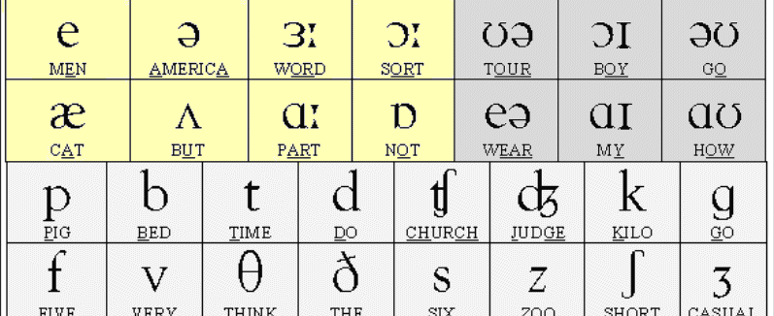
THE CONSONANTS OF ENGLISH RP
/p/ as in pin
/b/ as in big
/t/ as in tin
/d/ as in din
/k/ as in kit
/g/ as in give
/f/ as in fan
/v/ as in van
This Photo by Unknown Author is licensed under CC BY-SA-NC

Slide 98
/ θ/ as in thin
/ ð /as in that
/s/ as in sin
/z/ as in zip
/ ʃ / as in ship
/ ʒ / as in pleasure
/h/ as in hat
/ ʧ /as in chat

Slide 99
/ ʤ/ as in jug
/m/ as in man
/n/ as in name
/ ŋ / as in ink
/j/ as in you
/w/ as in what
/r/ as in rat
/l/ as in lip

Slide 100


Slide 101
Reference
https://www.ispatguru.com/role-of-communication-in-the-organization/#:~:text=The%20purpose%20of%20communication%20in,encourage%20employees'%20participation%20in%20decision
https://www.psychologydiscussion.net/essays/personality-development/communication-skills/communication-skills-meaning-code-and-content/1240
https://www.coursesidekick.com/business/study-guides/wmopen-introbusiness/communication-channels-flows-networks#:~:text=Communication%20within%20a%20business%20can,%2C%20horizontal%2C%20diagonal%2C%20external.

